Slide 1
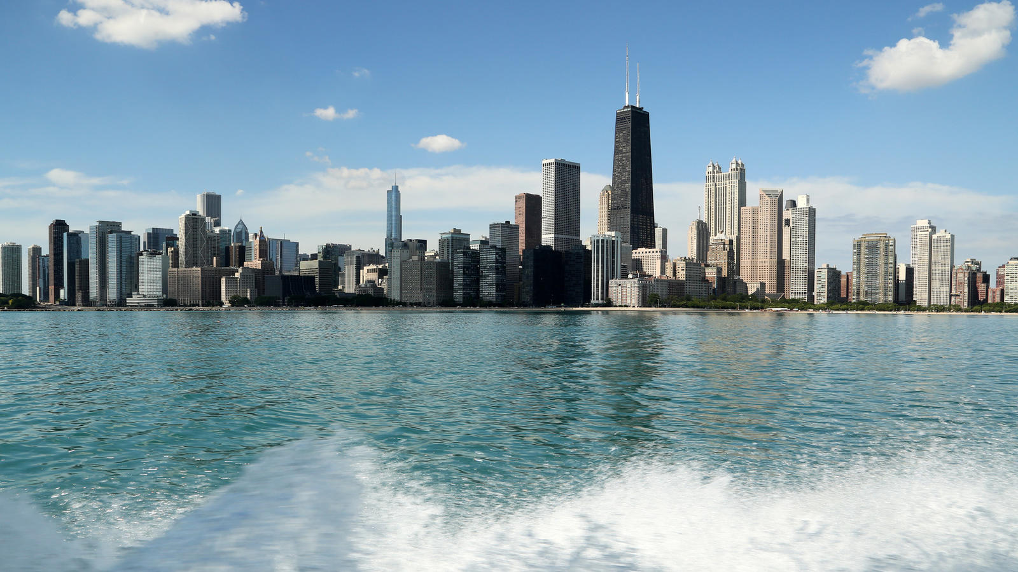

Docassemble Toolkit
Docacon Community.lawyer
Chicago, IL
2018

Slide 2
1. Community.lawyer
2. why we think docassemble is exciting
3. what we've built so far and why
4. what we're building next
5. q&a / discussion

Slide 3
Community.lawyer

Slide 4
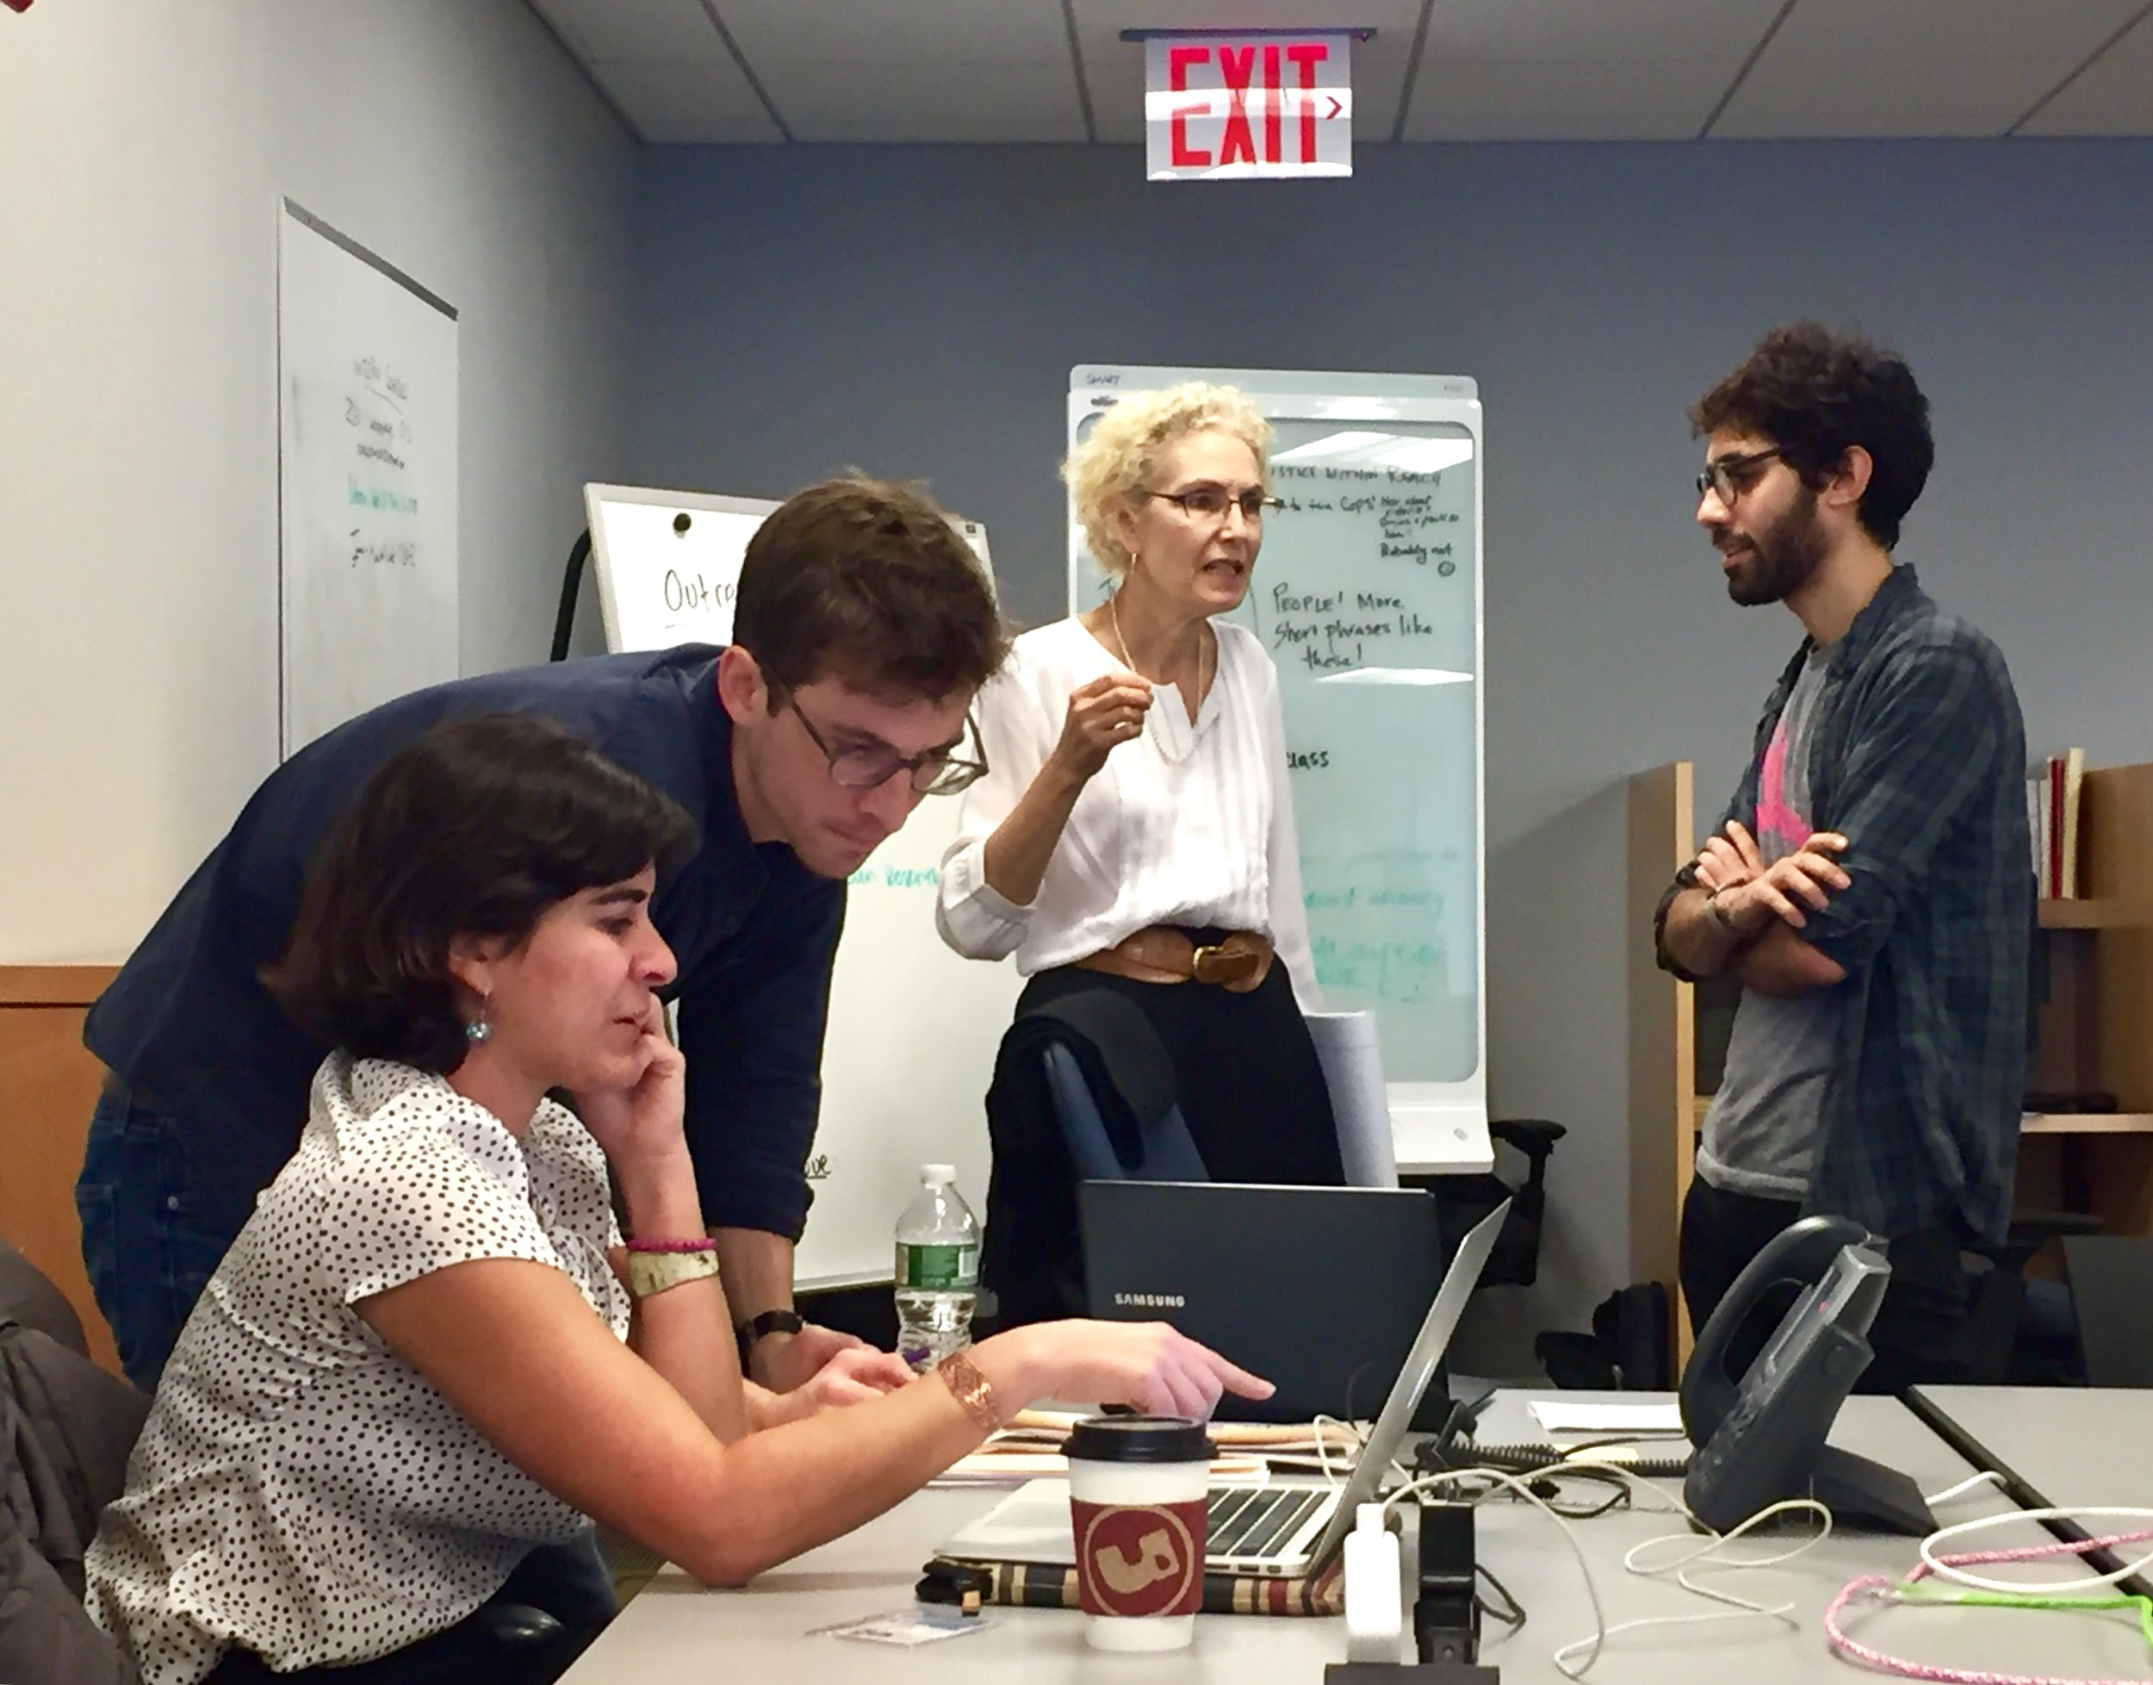



Slide 5
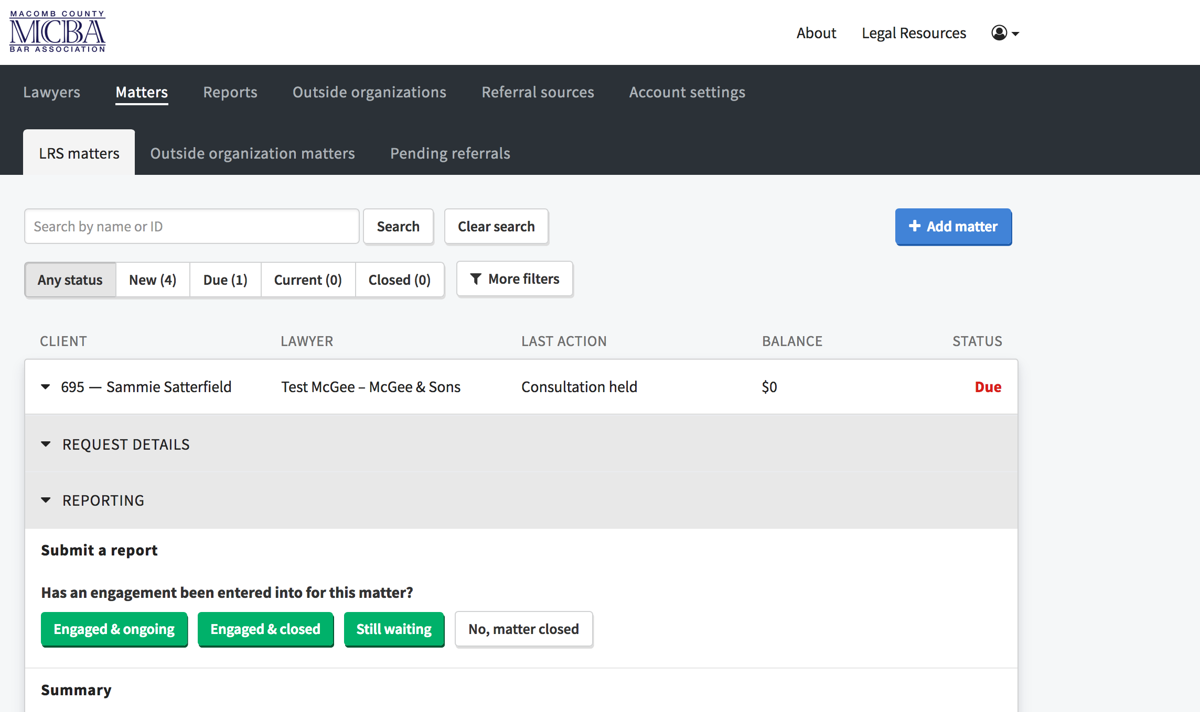

Slide 6





Slide 7
2. why we think docassemble is exciting

Slide 8
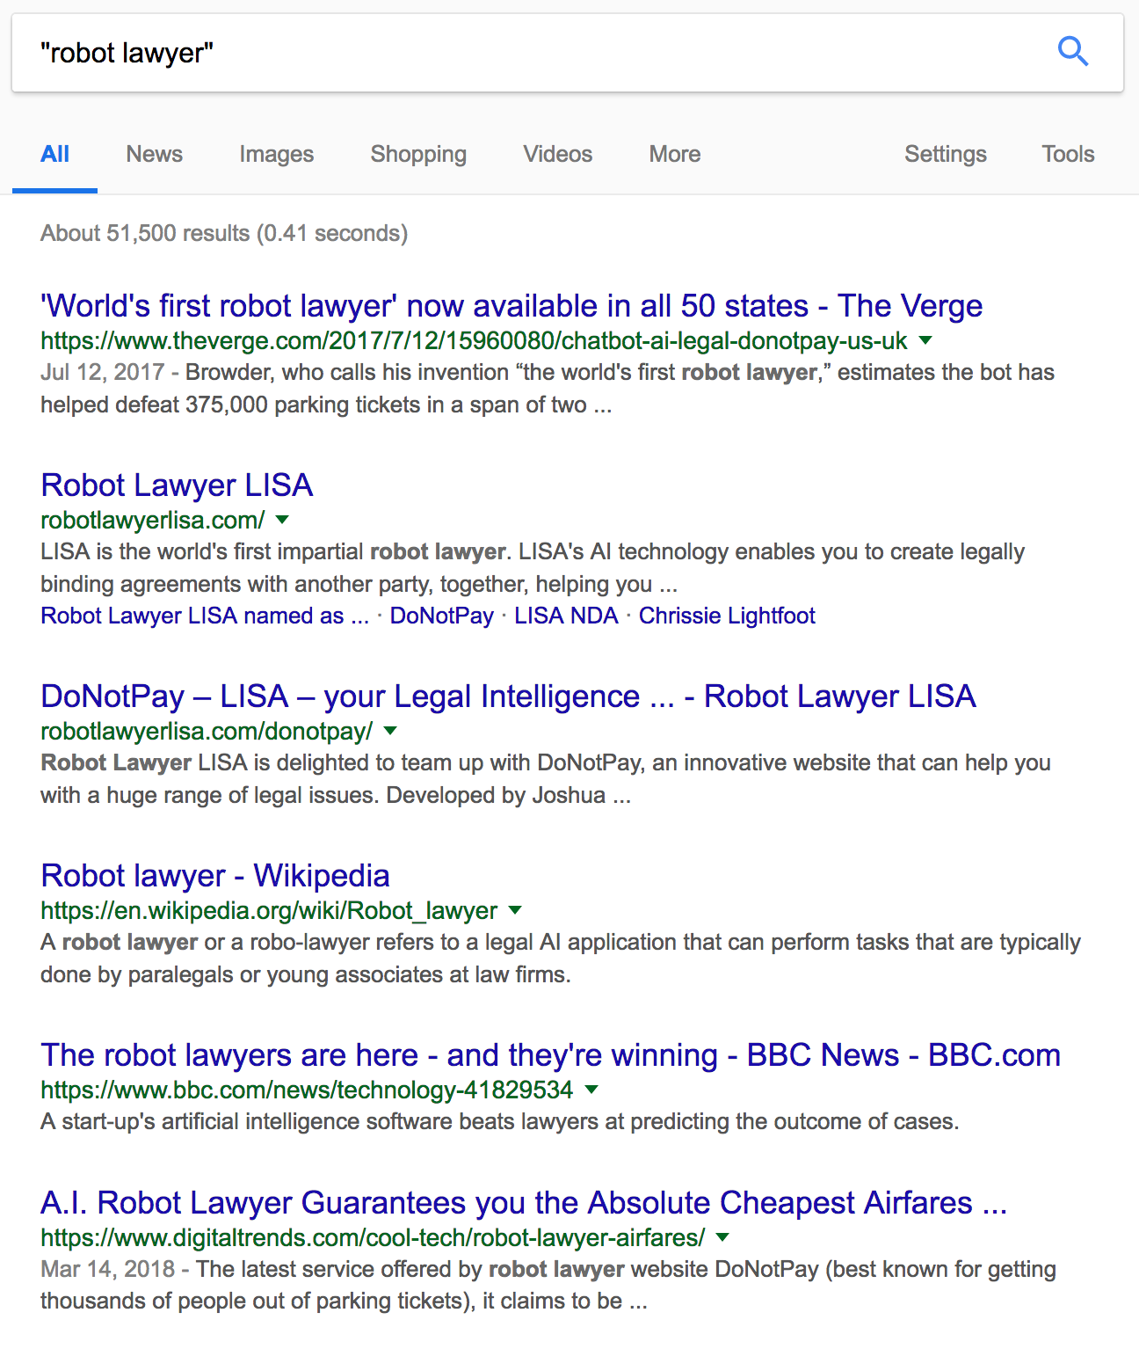

Slide 9
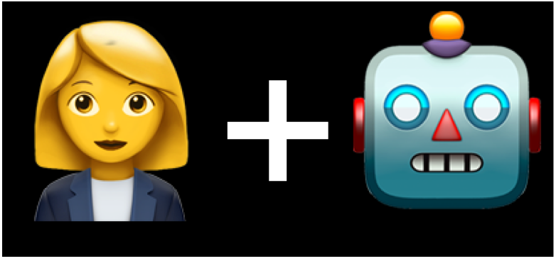

Slide 10
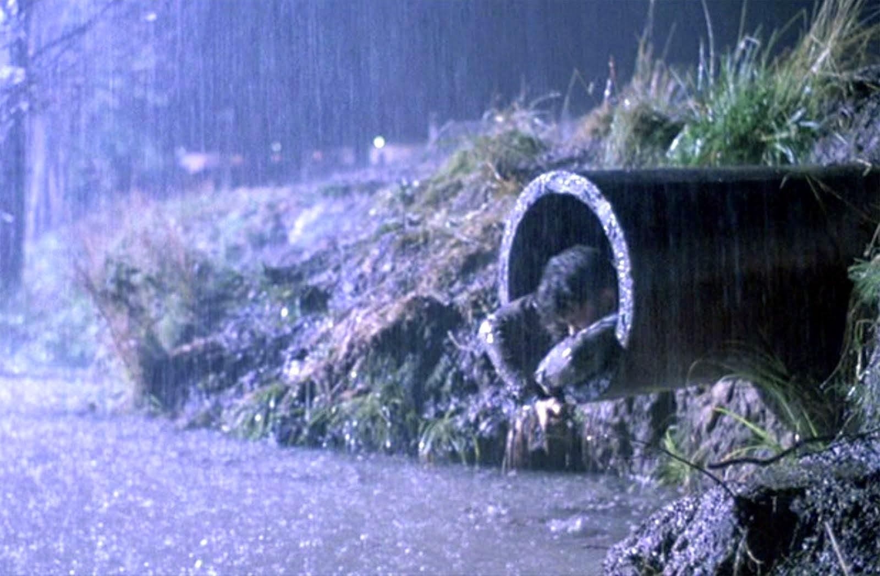

Slide 11
docassemble
expensive proprietary legacy systems

Slide 12
3. what we’ve built so far and why

Slide 13
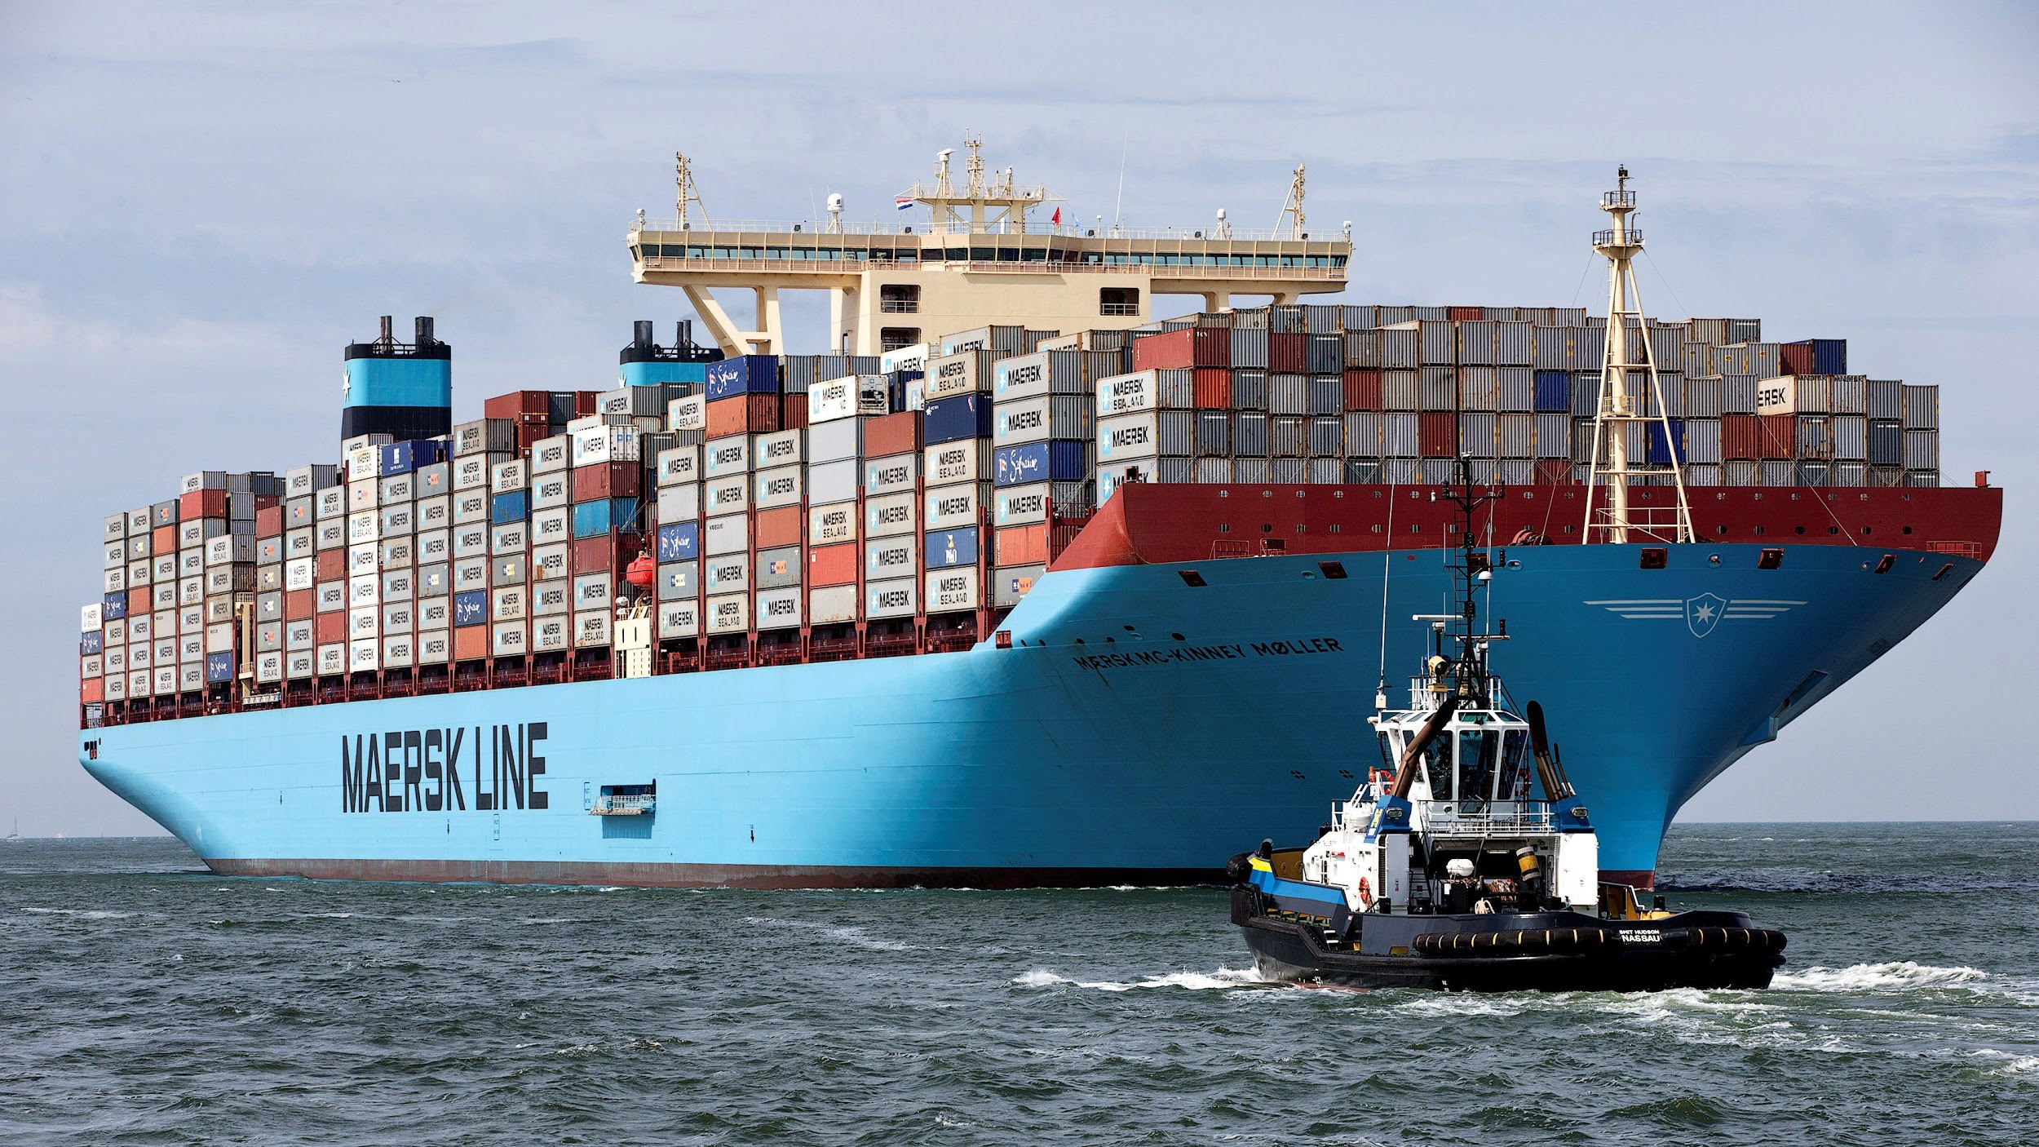

Slide 14
Servers
Answers
Leads

Slide 15
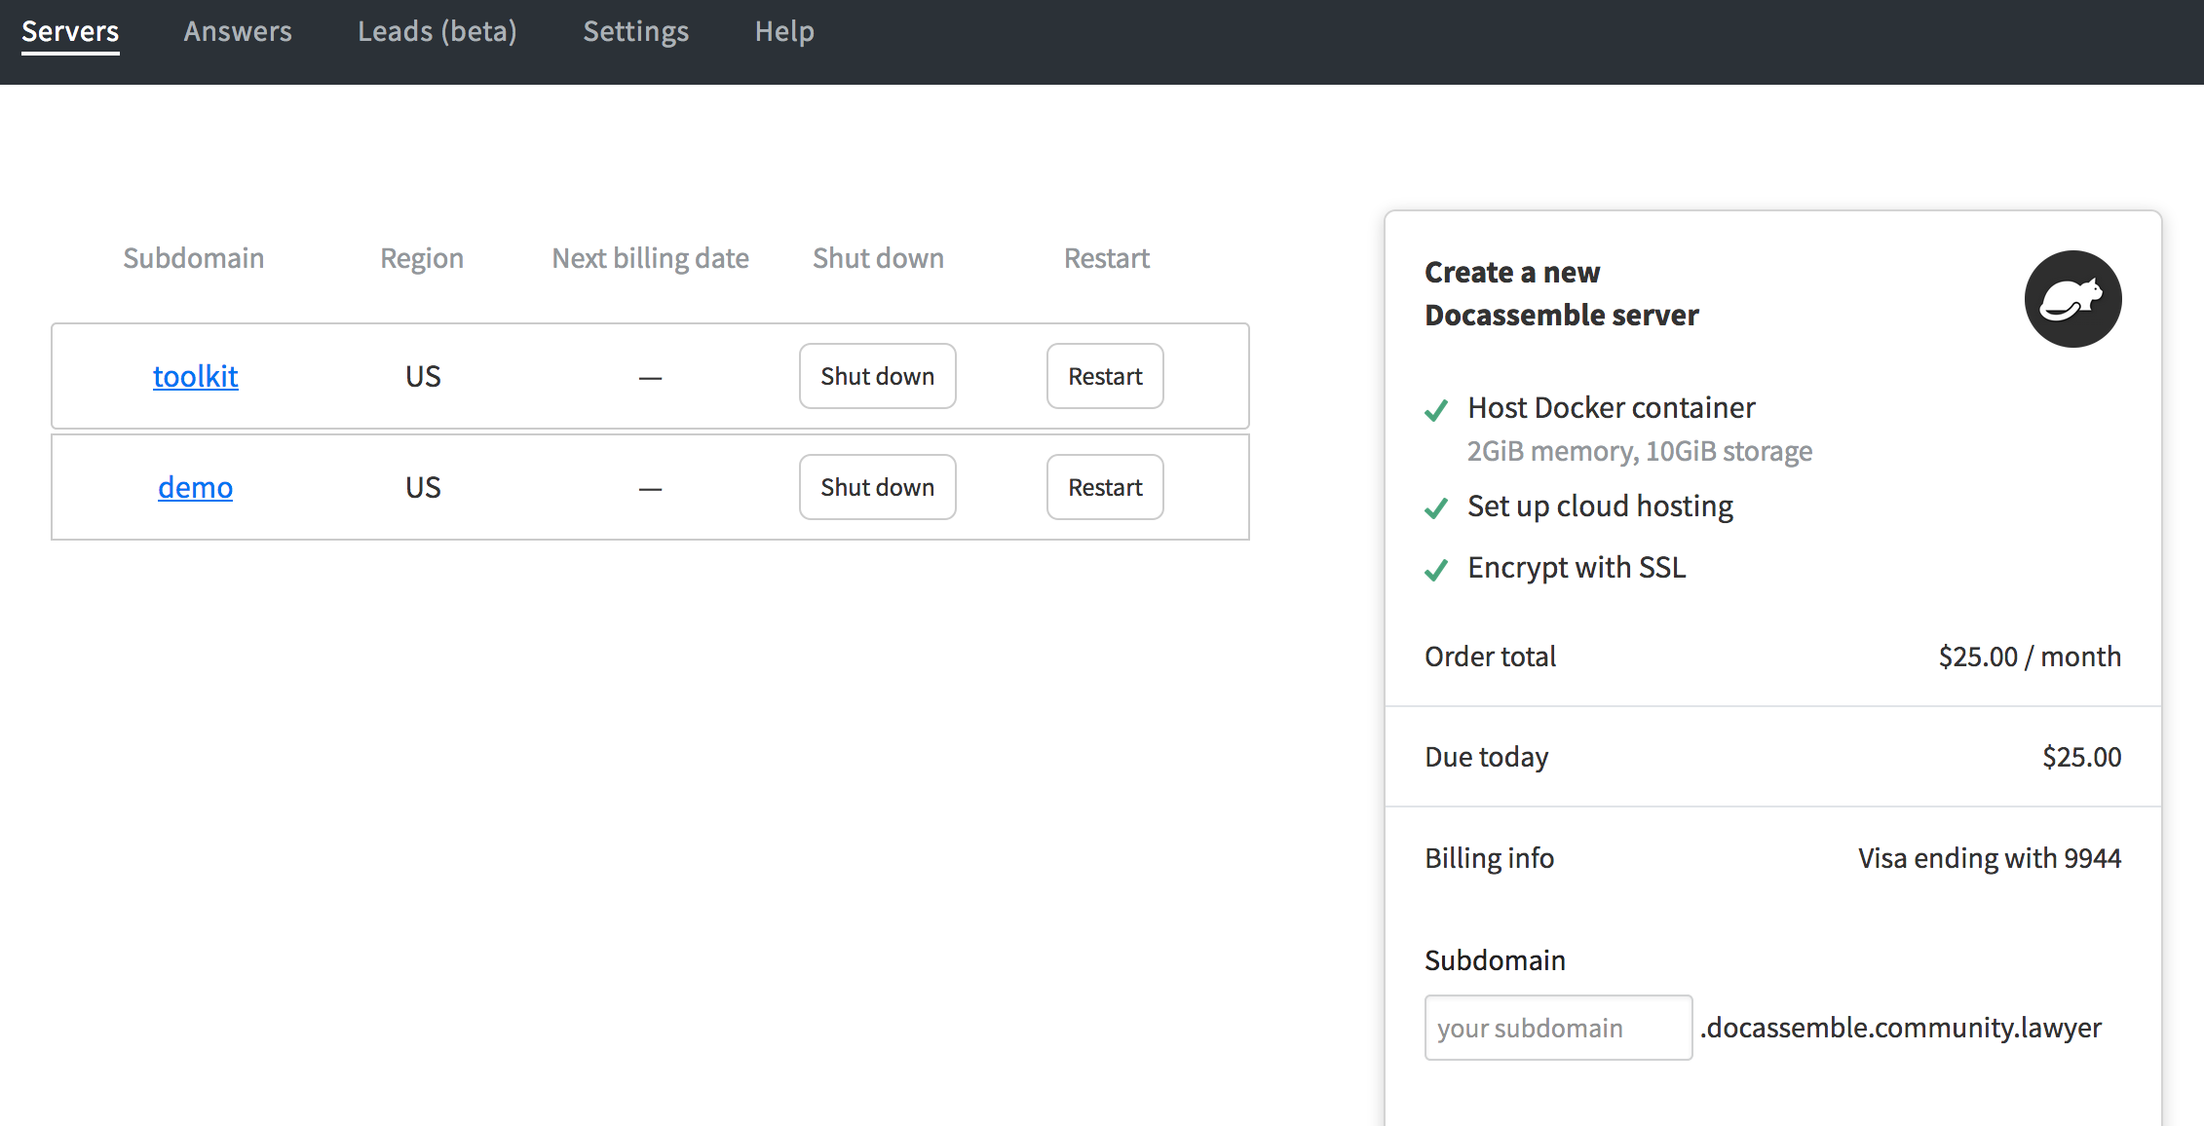
Servers

Slide 16
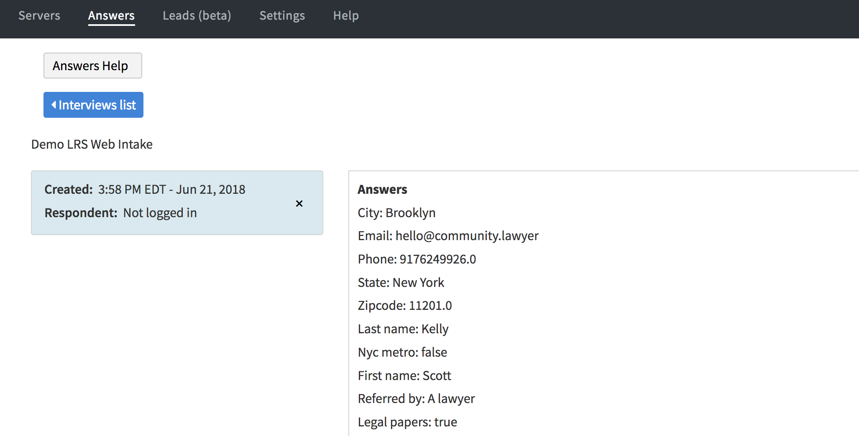
Answers

Slide 17
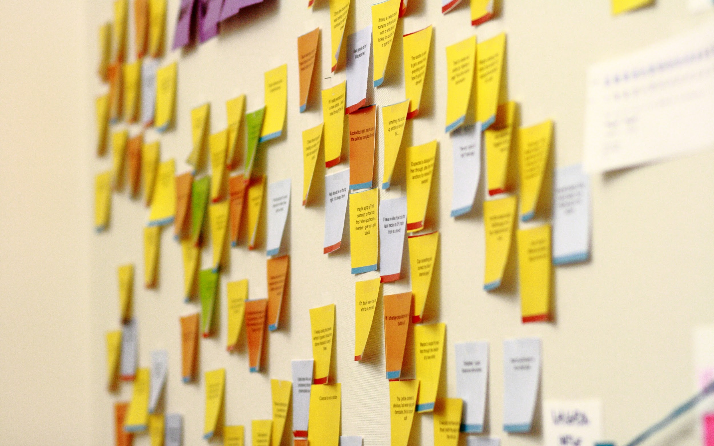
Leads

Slide 18
4. what we’re building next

Slide 19
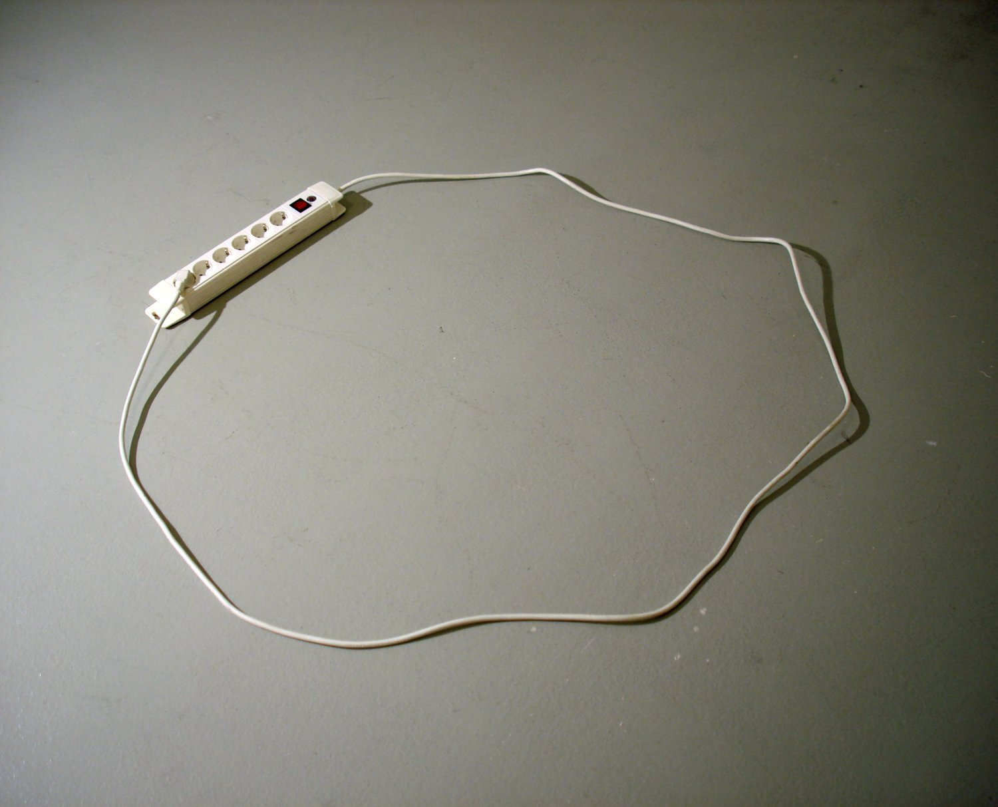
Referral API

Slide 20
Intake app (Docassemble)
User
LRS
Attorney

Slide 21
$ (maybe???)
$
Intake app (Docassemble)
User
LRS
Attorney
$

Slide 22
$ (maybe???)
$
Intake app (Docassemble)
User
LRS
Attorney
$
Probably crazy. Also probably worth trying

Slide 23
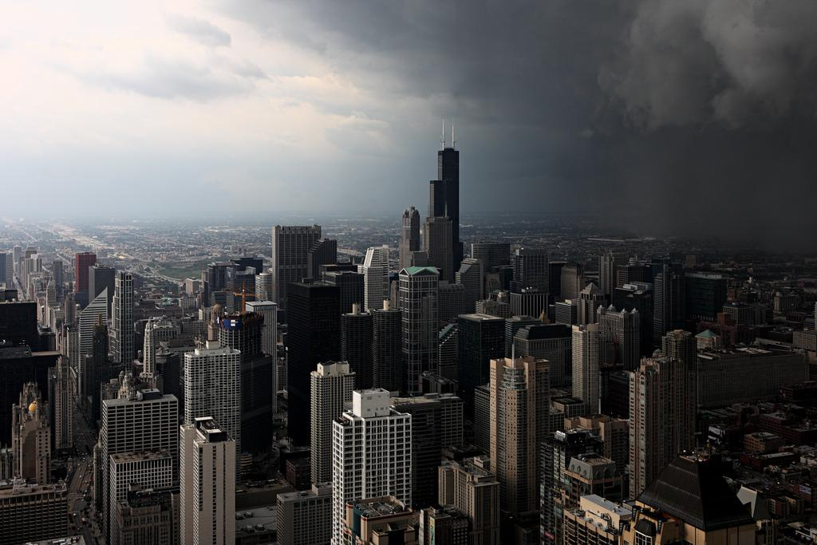

Slide 24
Come and show me another city with lifted head singing so proud to be alive and coarse and strong and cunning.
Flinging magnetic curses amid the toil of piling job on job, here is a tall bold slugger set vivid against the little soft cities;
Fierce as a dog with tongue lapping for action, cunning as a savage pitted against the wilderness,
Bareheaded,
Shoveling,
Wrecking,
Planning,
Building, breaking, rebuilding...

Slide 25
5. Q&A / discussion

Slide 26
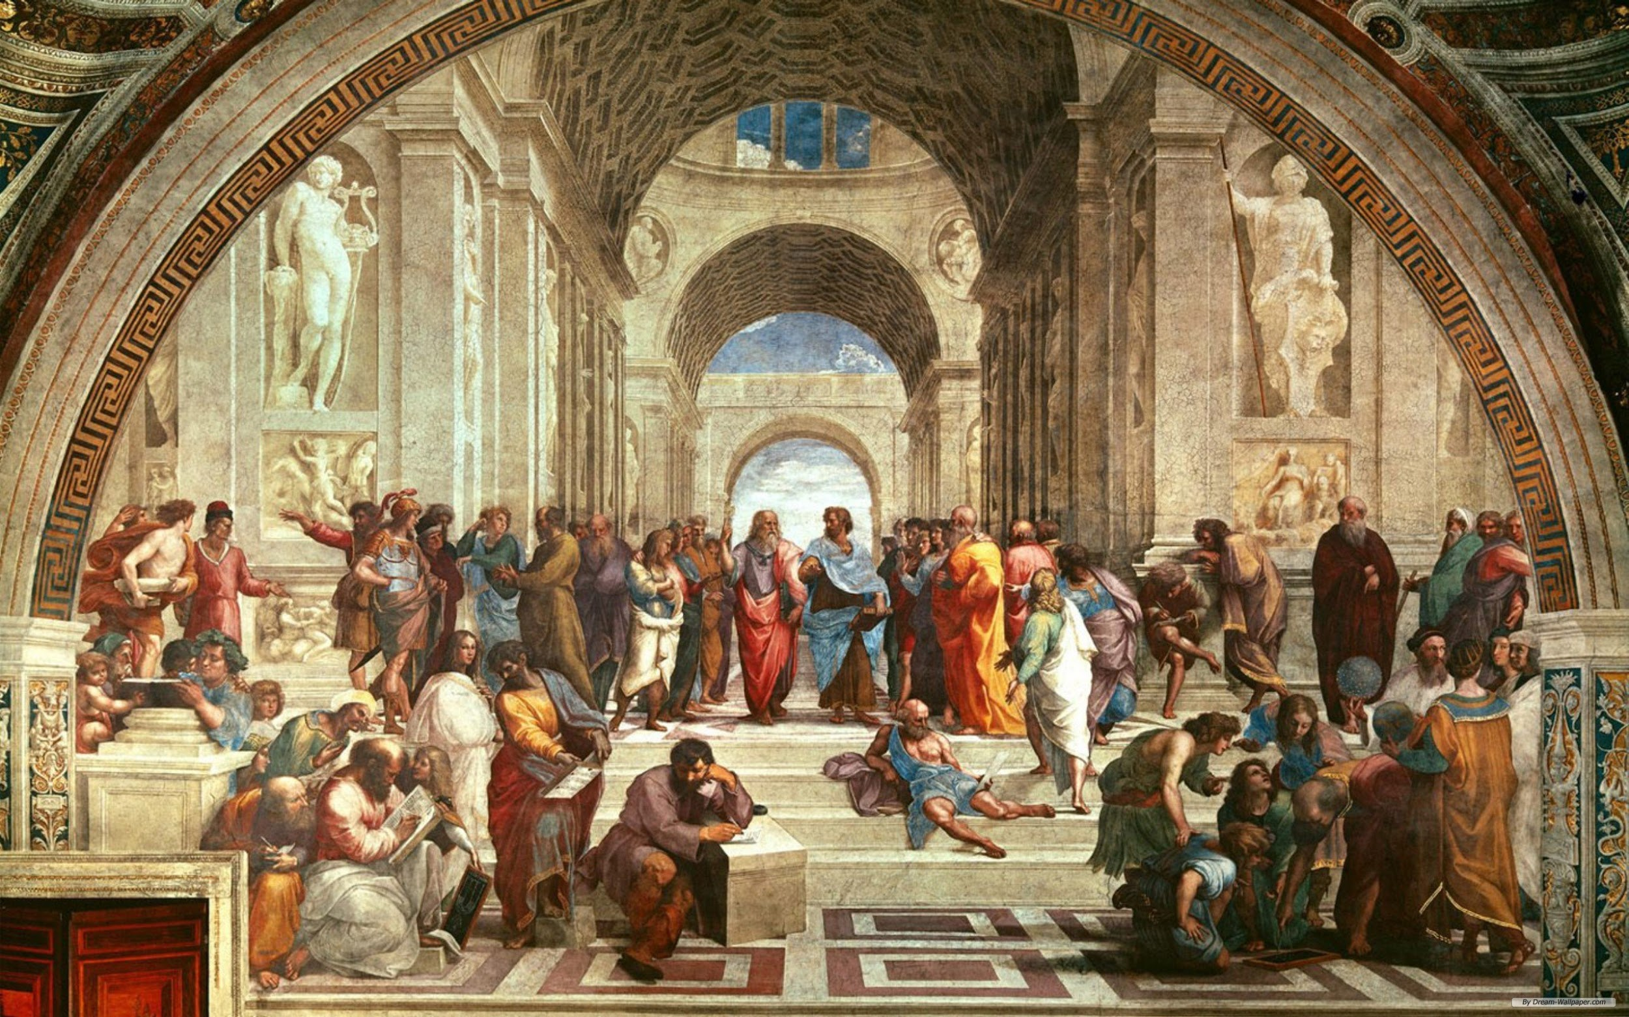
If you had an army of lawyers & developers, and didn’t have to worry about funding... what would you build?

